Slide 1


ONTOLOGY TOPIC: Phishing Ontology for Malicious Emails XAKA YAMKELA 3538718 SUPERVISOR: PROFFESOR LOUISE LEENEN COMPUTER SCIENCE(HONS)
University of the
Western Cape

Slide 2
background
An ontology that is identifying if an email is a phishing or normal Email.

Slide 3


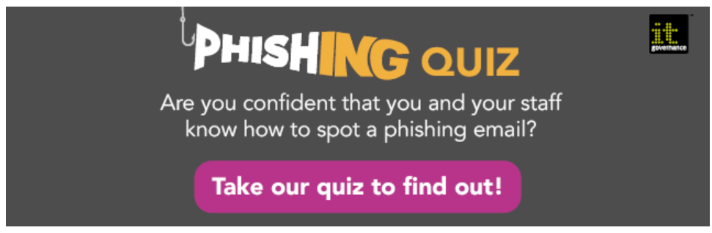
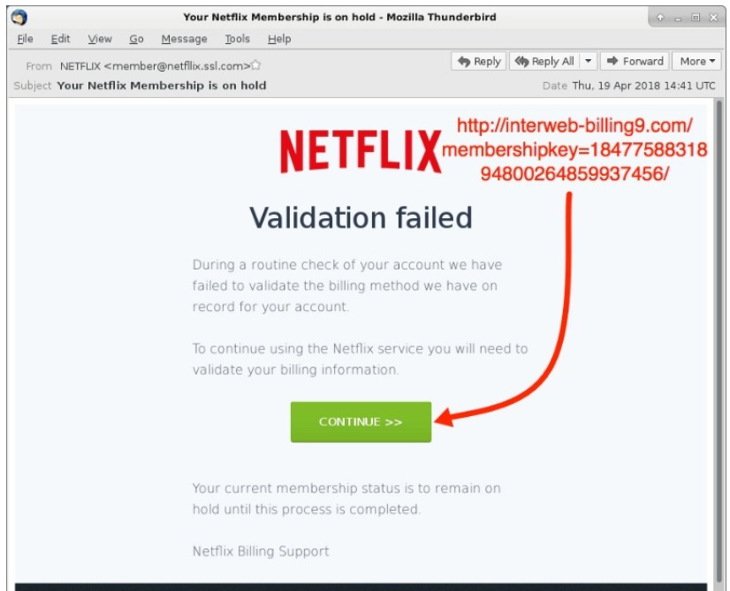

Implementation tools and Resources

Slide 4
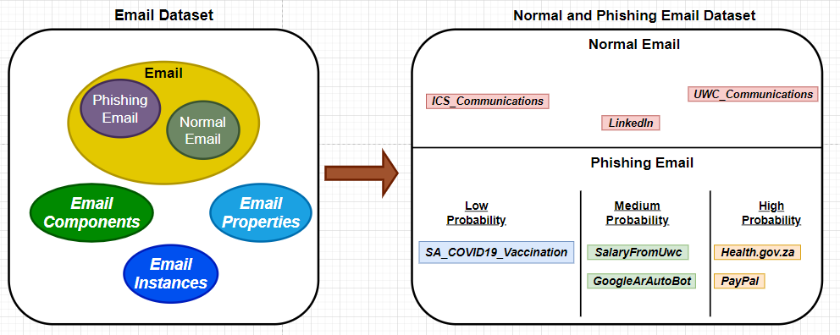
Design implementation

Slide 5
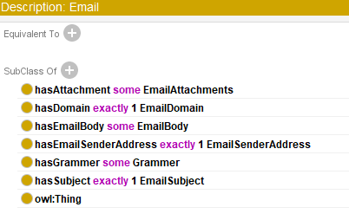
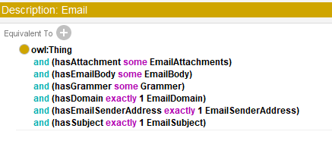

Definition of classes and subclasses
Primitive classes
Defined classes
Converted

Slide 6
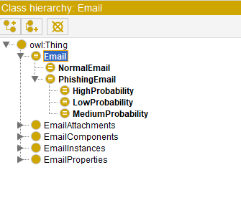
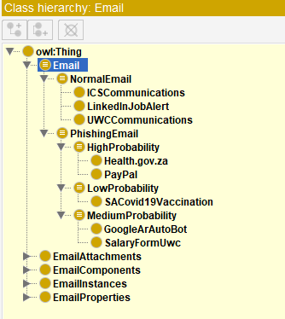
CLASS HIERARCHY FOR ASSERTED AND INFERRED CLASSES
After the Reasoner is Executed
Before the Reasoner is Executed

Slide 7
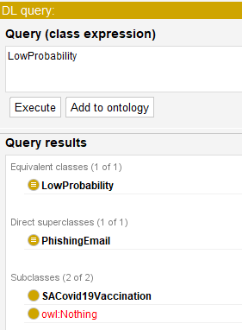
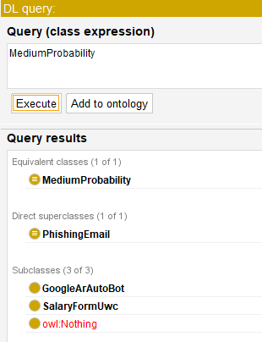
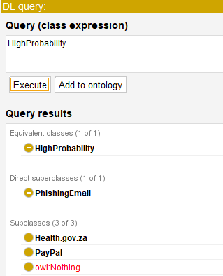
DL Query for low medium and high probability
Low Probability
Medium Probability
High Probability

Slide 8
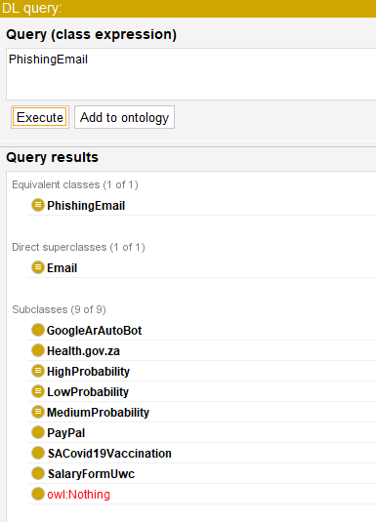
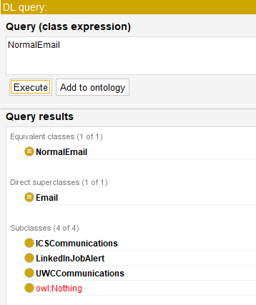
queries (cont..)
Phishing emails
Normal Emails

Slide 9
references
[1] A. Vedeshin, “Contributions Of Understanding And Defending Against Social Engineering Attacks,” 2016.
[2] “The 5 most common types of phishing attack - IT Governance Blog En.” [Online]. Available: https://www.itgovernance.eu/blog/en/the-5-most-common-types-of-phishing-attack. [Accessed: 06-Jun-2020].
[3] “When Phishing Starts from the Inside -.” [Online]. Available: https://blog.trendmicro.com/phishing-starts-inside/. [Accessed: 06-Jun-2020].
[4] F. Mouton, L. Leenen, M. M. Malan, and H. S. Venter, “Towards an Ontological Model Defining,” IFIP Int. Conf. Hum. Choice Comput., pp. 266–279, 2014.

Slide 10

Thank you.

